Slide 1
WEL-COME

Slide 2


Accredited by NAAC with B++ and ISO 9001:2015 Certified Institute SANT GAJANAN MAHARAJ COLLEGE OF ENGINEERING, MAHAGOAN
Mini Project on
Three Phase AC Voltage MonitoringUsing Arduino
Group Members-
Sr. No. | Name | Roll No | Class
01 | Mr. Roshan Ashok Avadan. | 01 | TY E&TC
02 | Mr. Shubham Dayanand Powar. | 07 | TY E&TC
03 | Mr. Sushilkumar Masanu Parase | 09 | TY E&TC

Slide 3
INDEX
Overview of Project
Circuit Diagram
Working Principle
Advantages and Limitations
Applications

Slide 4
Overview
The 3-phase AC voltage measurement project using Arduino aims to monitor and measure the voltage levels in a 3-phase power system.
By connecting voltage sensors to each phase and interfacing them with Arduino, the system can accurately capture and display real-time voltage data.
The Arduino microcontroller processes the sensor inputs and presents the information on an output device such as an LCD or serial monitor, enabling users to monitor and analyze the electrical system's performance.

Slide 5
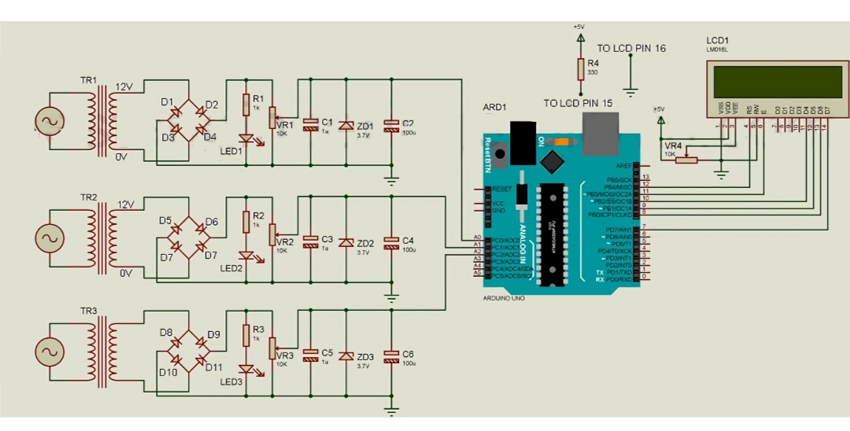
Circuit Diagram

Slide 6
Working
High AC input voltage is first converted to lower AC voltage with the help of a transformer and then rectifier using a full-wave bridge rectifier.
The output of the rectifier is given to the voltage divider network which lowers the rectified output DC voltage and further filters and passes to the zener diode.
The output is given to Arduino input analog input pin A0.

Slide 7
Advantages
Low cost (Approximate Expenditure: Rs. 1,500/-).
Can measure AC voltage of any amplitude.
Show individual phase voltage.
LED indication for individual phase voltage.

Slide 8
Limitation
Phase angle ambiguity.
Harmonic interference.
Voltage unbalance.
Instrument limitations.

Slide 9
Application
Power Distribution.
Motor control.
Power Quality Analysis.

Slide 10
THANK YOU…

